Slide 1



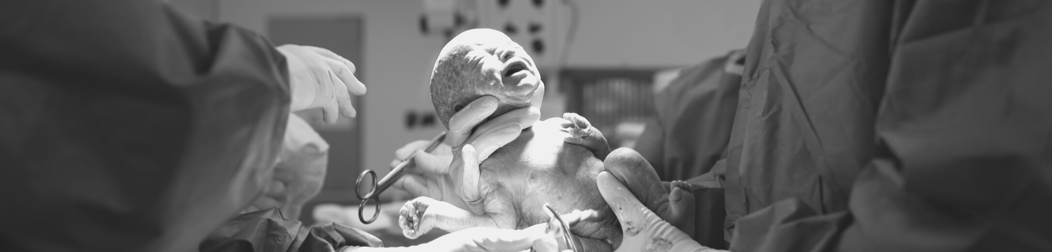



MATERNAL SPOTLIGHT

Slide 2

WE BELIEVE
EVIDENCE
EMPOWERS
EQUITY
We seek to make maternal well-being more equitable through evidence-based empowerment of women, birthing parents, caregivers, families, and communities.
Our Purpose.

Slide 3

The Birth of Maternal Spotlight.

Slide 4

The
Maternal Spotlight
Framework:
A New Approach
IDENTITY
FERTILITY
PRENATAL
Maternal
Experience
CAREGIVING
CHILDBIRTH
LOSS
POSTPARTUM
RELATIONSHIPS

Slide 5







As a team of social scientists, clinicians, and birth workers, we are committed to addressing a range of maternal experiences - including those that are not fully understood.
Our Team.

Slide 6

Podcast Series
Microgrant Program
What we do.

Slide 7
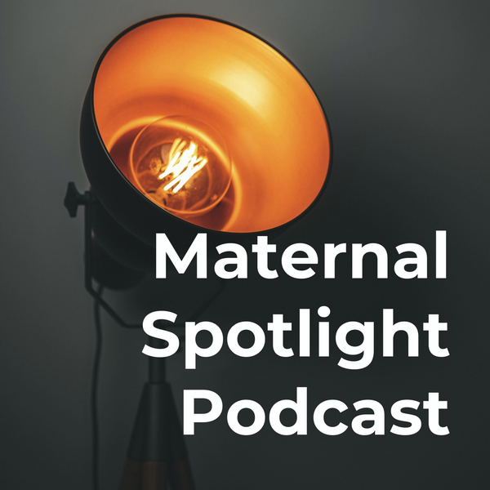

  Evidence
  Resources
  Tools
  Connecting Women in Need
HOW OFTEN DO WOMEN RECEIVE RECOMMENDED FOLLOW-UP CARE AFTER BABY?
QUALITY OF MATERNAL CARE PROJECT
MEDICAL GUIDELINES
In the past, the American College of OBGYNs has recommended that most women have a postpartum checkup 4 to 6 weeks after giving birth.
FOLLOW-UP CARE IMPROVES HEALTH
  Reduce morbidities and deaths
  Improve patient satisfaction
  Address problems with depression and chronic conditions
  Assess breastfeeding and bonding
  Discuss contraception
HOW MANY MOTHERS GET TO THIS APPOINTMENT IN THE UNITED STATES?
There is surprisingly little evidence on how often women are visiting their providers after childbirth.
WE INVESTIGATED.
52.5%
MOTHERS
Offering Support.
received a postpartum
follow-up visit within 60 days of childbirth
SOURCE: AUTHORS’ ANALYSIS, DISTRIBUTION OF MEDICAL EVENTS, MEDICAL EXPENDITURE PANEL SURVEY, 2005-2015. PRESENTED AT THE AMERICAN PUBLIC HEALTH ASSOCIATION ANNUAL CONFERENCE, PHILADELPHIA 2019.
WE CAN LEARN MORE TOGETHER.
Get involved. maternalspotlight.org

Slide 8

Join Us.

